Slide 1

Datta Meghe College of Engineering , Airoli LINEAR PROGRAMMING PROBLEMS
Group Members :
SHITAL KACHARE - 53
RATNAKAR GARJE - 54
JIDNYASA BHOIR - 55

Slide 2
TWO – PHASE SIMPLEX METHOD
DEFINITION
In Two Phase Method, the whole procedure of solving a linear programming problem (LPP)involving artificial variables is divided into two phases.
In Phase 1, we solve an auxiliary LP problem to either get a feasible basis or conclude that (P) is infeasible.
In Phase 2, we solve (P) starting from the feasible basis found in Phase 1 .
Using simplex method make iterations till an optimal basic feasible solution for it is obtained.
It may be noted that the new objective function is always of minimization type regardless of whether the given (original ) L.P.P. is of maximization or minimization type.

Slide 3
Steps :
Step-1: | Phase-1 a. Form a new objective function by assigning zero to every original variable (including slack and surplus variables) and -1 to each of the artificial variables. eg. Max Z = - A1 - A2 b. Using simplex method, try to eliminate the artificial varibles from the basis. c. The solution at the end of Phase-1 is the initial basic feasible solution for Phase-2.
Step-2: | Phase-2 a. The original objective function is used and coefficient of artificial variable is 0 (so artificial variable is removed from the calculation process). b. Then simplex algorithm is used to find optimal solution.

Slide 4
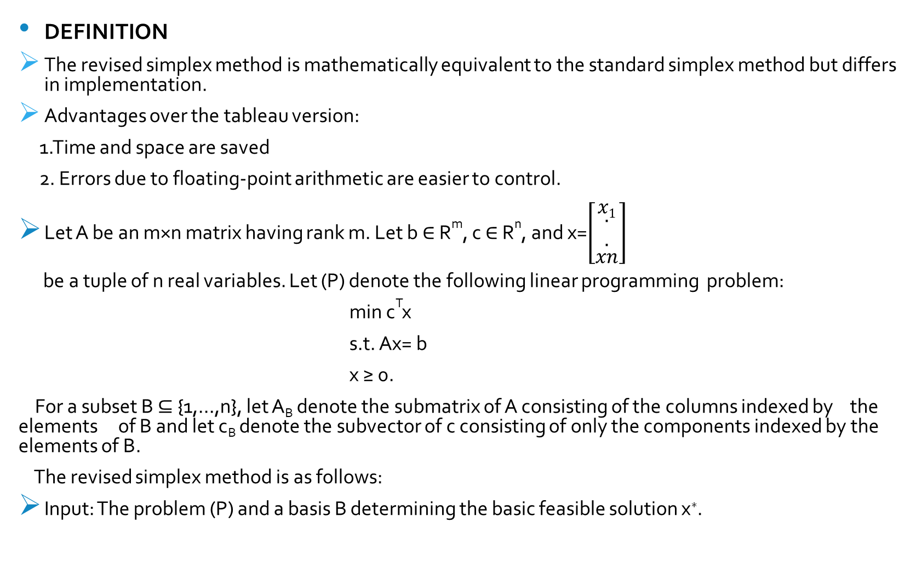
Revised Simplex Method
DEFINITION
The revised simplex method is mathematically equivalent to the standard simplex method but differs in implementation.
Advantages over the tableau version:
1.Time and space are saved
2. Errors due to floating-point arithmetic are easier to control.
Let A be an m×n matrix having rank m. Let b ∈ R^{m}, c ∈ R^{n}, and x=$\left[\begin{matrix}x1 \\ \begin{aligned}. \\ .\end{aligned} \\ xn\end{matrix}\right]$
be a tuple of n real variables. Let (P) denote the following linear programming problem:
min c^{T}x
s.t. Ax= b
x ≥ 0.
For a subset B ⊆ {1,…,n}, let A_{B} denote the submatrix of A consisting of the columns indexed by the elements of B and let c_{B} denote the subvector of c consisting of only the components indexed by the elements of B.
The revised simplex method is as follows:
Input: The problem (P) and a basis B determining the basic feasible solution x∗.

Slide 5
Steps :
Let N={1,…,n}∖B.
Solve y^{T}A_{B}=c_{B}^{T} where y=[y₁,…,y_{m}]^{T}.
Choose k∈N such that y^{T}A_{k}>c_{k}. If no such k exists, then stop; x∗ is an optimal solution.
Find d=[d₁,…,d_{n}]^{T} such that d_{k}=1, d_{j}=0 for all j∈N∖{k}, and A_{B}d_{B}=−A_{k}.
If d≥0, then stop; the problem is unbounded.
Set λ=min{x_{i}∗/d_{i}:i∈B with d_{i}<0} and choose r∈B such that d_{r}<0 and x_{r}∗/−d_{r}=λ.
Replace x∗ with x∗+λd.
Replace B with (B∪{k})∖{r} and go to step 1.

